Slide 1
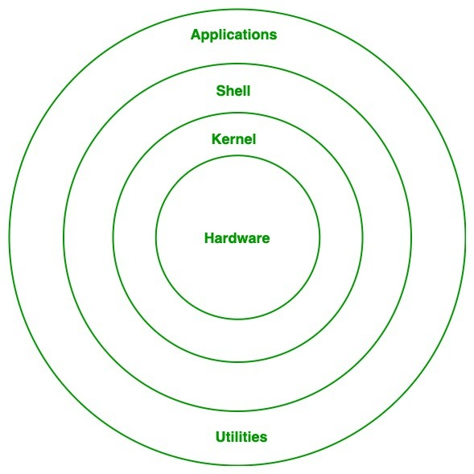
Linux
Linux is a free and open-source family of operating systems that is resilient and flexible.
In 1991, an individual by the name as Linus Torvalds constructed it

Slide 2
Linux
Release Year | Version/Name
1991 | Linux Kernel 0.01
2000 | Linux Kernel 2.4
2003 | Fedora Core 1
2004 | Ubuntu 4.10
2006 | Linux Kernel 2.6
2017 | Ubuntu 17.10
2019 | Linux Kernel 5.0
2020 | Linux on WSL 2
2023 | Linux Kernel 6.0

Slide 3
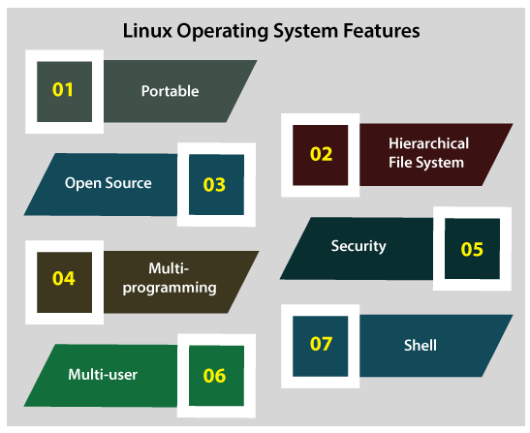
Linux

Slide 4
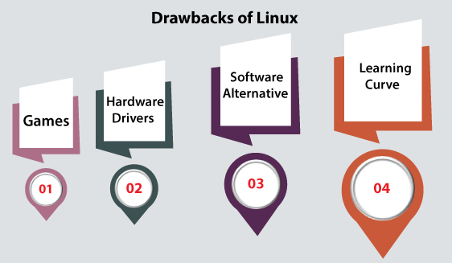
Linux

Slide 5
Design Principles of Linux
1. Modularity
2. Everything is a File
3. Small, Single-Purpose Programs
4. Text as a Universal Interface
5. Open Source Philosophy
6. Interoperability
7. Security and Stability
8. Community-Driven Development

Slide 6
IPC in Linux
1. Pipes
2. Message Queues
3. Shared Memory
4. Semaphores
5. Signals
6. Sockets
7. File-Based IPC

Slide 7
Kernel Modules in Linux
Related articles
Kernel Modules are pieces of code that can be loaded and unloaded into the kernel upon demand.
Features of Kernel Modules
Dynamic Loading and Unloading: Modules can be added or removed without restarting the system.
Modularity: Keeps the kernel lightweight by including only the necessary components.
Reusability: Modules can be reused across different systems and configurations.
Common Use Cases
Device Drivers:
File Systems:
Network Protocols:
Custom Extensions:
Lifecycle of a Kernel Module
Loading:
Running:
Unloading:

Slide 8
Network structure in Linux
Components of Linux Network Structure
Network Stack
The Linux kernel implements a modular network stack with layers following the OSI or TCP/IP model.
Network Interfaces
Physical or virtual interfaces connect the system to a network.
Routing Table
Linux maintains a routing table to determine how packets are forwarded.
Firewall and Packet Filtering
Network Namespaces
Provide isolated network environments for containers or virtualized applications.
Virtual Networking
Kernel Sockets
Sockets provide APIs for inter-process and network communication.

Slide 9
Security in Linux
1. User and Permissions Management
2. Authentication
3. Access Control
4. System Updates and Patching
5. Network Security
6. Malware and Exploit Protection
7. Log Management and Monitoring
8. Encryption
9. Backup and Recovery

Slide 10
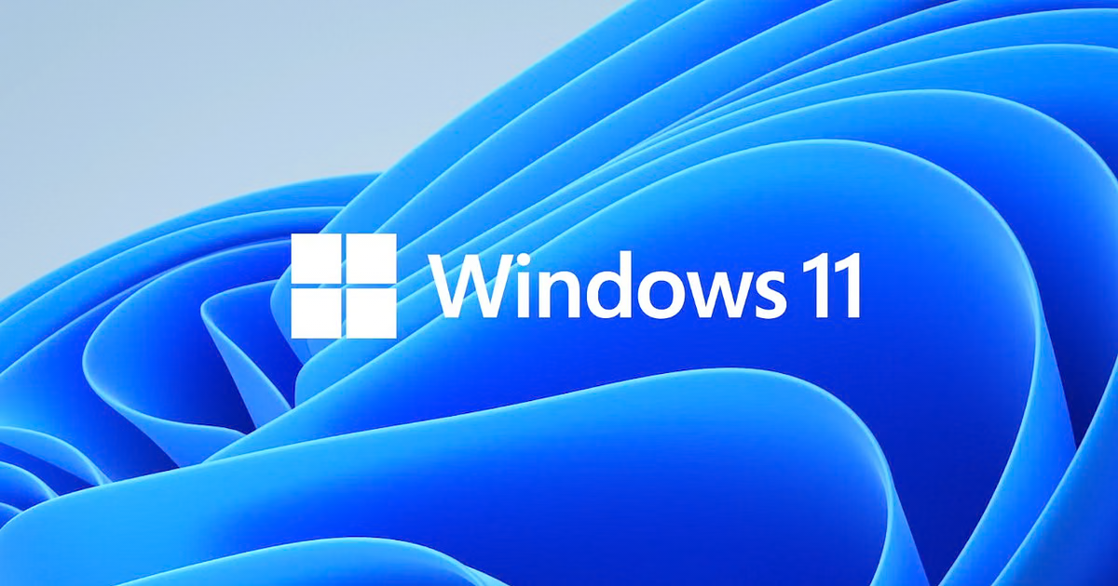
Windows
1. User Interface (UI)
2. File Management
3. Security Features
4. Compatibility
5. Productivity Features
6. Networking and Internet
7. Gaming Features
8. Multimedia
9. Customization
10. Advanced Features
11. Connectivity and Cloud

Slide 11
Windows
Release Year | Version
1985 | Windows 1.0
1995 | Windows 95
1998 | Windows 98
2000 | Windows 2000
2000 | Windows ME (Millennium Edition)
2001 | Windows XP
2007 | Windows Vista
2009 | Windows 7
2012 | Windows 8
2013 | Windows 8.1
2015 | Windows 10
2021 | Windows 11

Slide 12
Design Principle of Windows OS
1. Modularity and Extensibility
2. Compatibility
3. User-Centric Design
4. Performance and Efficiency
5. Security and Reliability
6. Interoperability
7. Usability
8. Scalability and Multiuser Support
9. Networking and Connectivity
10. Innovation and Adaptability

Slide 13
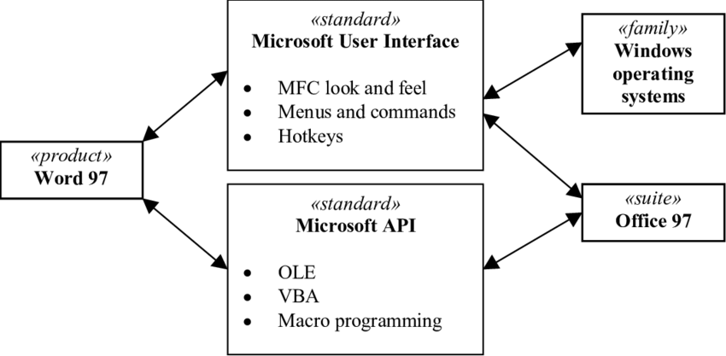
Programming Interface of Windows OS

Slide 14
System components of Windows OS
1. Kernel
2. Hardware Abstraction Layer (HAL)
3. System Processes

Slide 15
Security Levels in Windows OS
1. User Authentication
2. Access Control
3. Data Protection
4. Malware Protection
5. Network Security
6. Threat Detection and Response
7. Application Security
8. Enterprise Security
9. Cloud Integration and Backup
10. Security Levels by Edition

Slide 16
THANK YOU

